Slide 1
Employee Data Analysis using Excel
STUDENT NAME: SWETHA.P
REGISTER NO : 312209871
MN ID: 0B8986E1302EE1F8BC049255795A8A96
DEPARTMENT: B.COM (ACCOUNTING&FINANCE)
COLLEGE: VALLIAMMAL COLLEGE FOR WOMEN

Slide 2
PROJECT TITLE
Employee Salary Analysis using Excel

Slide 3


AGENDA
Problem Statement
Project Overview
End Users
Our Solution and Proposition
Dataset Description
Modelling Approach
Results and Discussion
Conclusion
3/21/2024 Annual Review

Slide 4

PROBLEM STATEMENT
The company’s salary budget is limited, but employees turnover is high due to low salaries. How can optimize our salary structure to retain employees within the given data
WHY EMPLOYEE PERFORMANCE ANALYSIS ?
To track the performance of Employees in an organization.
To focus on the growth of the organization as well as the growth of the Employee.
To motivate the employees through appreciation’s, increments, promotions etc. Will make them to work more in a more effective manner.

Slide 5

PROJECT OVERVIEW
Analyze employees salaries date to identified trends, disparities, and areas for improvement. Develop a fair competitive salary structure to retain and attract top talent. Optimize salary budget allocation to meet business objectives.

Slide 6

WHO ARE THE END USERS?
The end users are:
1.Human resources (HR)
2.Finance managers
3.Department heads
4.Board of directors
5.Government agencies
6.Employees of the company
These are the end users may utilize the insights from the salary analysis.

Slide 7

OUR SOLUTION AND ITS VALUE PROPOSITION
Pivot table
Conditional formatting
Filter
Pie chart

Slide 8
Dataset Description
Employee Dataset Excel downloaded from Kaggle.com
IT has 9 features. Here we consider only 6 features such as:
Employee id
Gender
Department
Salary
Employee type
Work location

Slide 9

THE "WOW" IN OUR SOLUTION
In this employees salary analysis we had to identify the Employees types of works are fixed term, permanent and temporary term of each employees.
3/21/2024 Annual Review
9

Slide 10
MODELLING
DATA COLLECTION _ downloaded from edunet dashboard
FEATURE SELECTION _ Identified each and every feature related to employee data set in Excel.
PERFORMANCE LEVEL OF SALARY_ fixed term, permanent, temporary.
DATA CLEANING_ filtered
DATA VISUALIZATION_ Graphical representation.
10

Slide 11
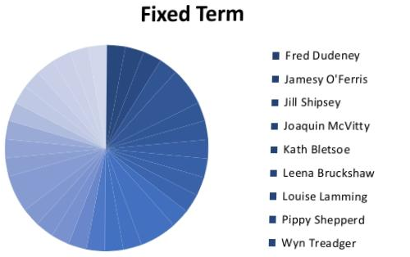
RESULTS
11

Slide 12
Conclusion
The employee salary analysis revealed key insights, highlighting areas for improvement. Recommendations include adjusting salary ranges and implementing performance-based raises. Implementing these changes will improve pay equity, attract and retain talent, optimize the compensation budget, and drive business outcomes. Next steps include implementing changes, monitoring data, communicating with employees, and continuously refining the compensation strategy.

